Slide 1
MIPI Protocol Introduction
MIPI Development Team
2010-9-2

Slide 2
What is MIPI?
MIPI stands for Mobile Industry Processor Interface
  MIPI Alliance is a collaboration of mobile industry leaders.
  Objective to promote open standards for interfaces to mobile
  application processors.
  Intends to speed deployment of new services to mobile users by
  establishing Spec.
Board Members in MIPI Alliance
  Intel, Motorola, Nokia, NXP,Samsung, ST, TI

Slide 3
What is MIPI?
MIPI Alliance Specification for display
  DCS (Display Command Set)
    DCS is a standardized command set intended for command mode display modules.
  DBI, DPI (Display Bus Interface, Display Pixel Interface)
    DBI：Parallel interfaces to display modules having display controllers and frame buffers.
    DPI：Parallel interfaces to display modules without on-panel display controller or frame buffer.
  DSI, CSI (Display Serial Interface, Camera Serial Interface)
    DSI specifies a high-speed serial interface between a host processor and display module.
    CSI specifies a high-speed serial interface between a host processor and camera module.
  D-PHY
    D-PHY provides the physical layer definition for DSI and CSI.

Slide 4
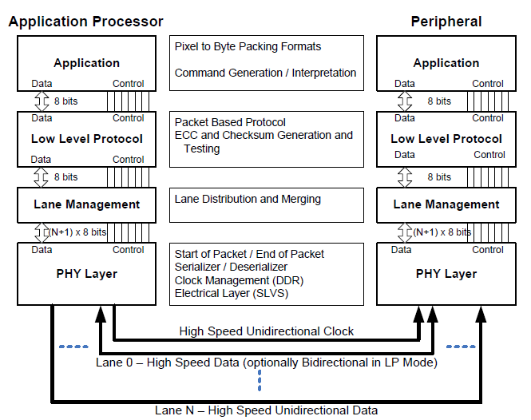
DSI Layers
DCS spec
DSI spec
D-PHY spec

Slide 5
Outline
D-PHY
  Introduction
  Lane Module, State and Line levels
  Operating Modes
    Escape Mode
  System Power States
  Electrical Characteristics
  Summary

Slide 6
Introduction for D-PHY
D-PHY describes a source synchronous, high speed, low power, low cost PHY
A PHY configuration contains
  A Clock Lane
  One or more Data Lanes
Three main lane types
  Unidirectional Clock Lane
  Unidirectional Data Lane
  Bi-directional Data Lane
Transmission Mode
  Low-Power signaling mode for control purpose：10MHz (max)
  High-Speed signaling mode for fast-data traffic：80Mbps ~ 1Gbps per Lane
D-PHY low-level protocol specifies a minimum data unit of one byte
  A transmitter shall send data LSB first, MSB last.
D-PHY suited for mobile applications
  DSI：Display Serial Interface
    A clock lane, One to four data lanes.
  CSI：Camera Serial Interface

Slide 7
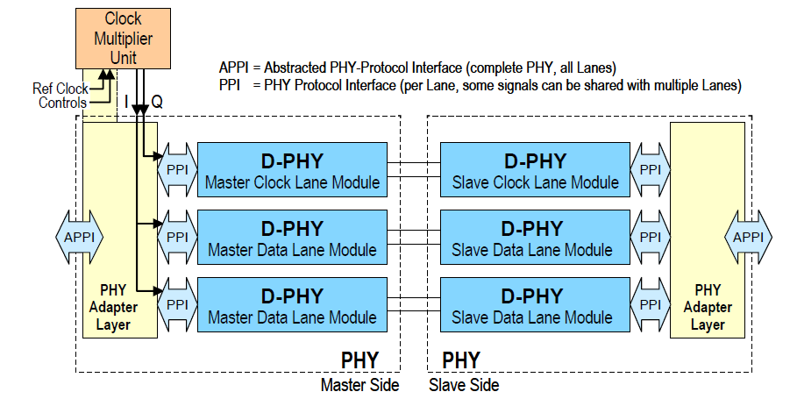
Two Data Lane PHY Configuration

Slide 8
Lane Module
PHY consists of D-PHY (Lane Module)
D-PHY may contain
  Low-Power Transmitter (LP-TX)
  Low-Power Receiver (LP-RX)
  High-Speed Transmitter (HS-TX)
  High-Speed Receiver (HS-RX)
  Low-Power Contention Detector (LP-CD)
Three main lane types
  Unidirectional Clock Lane
    Master：HS-TX, LP-TX
    Slave：HS-RX, LP-RX
  Unidirectional Data Lane
    Master：HS-TX, LP-TX
    Slave：HS-RX, LP-RX
  Bi-directional Data Lane
  Master, Slave：HS-TX, HS-RX,LP-TX, LP-RX, LP-CD

Slide 9
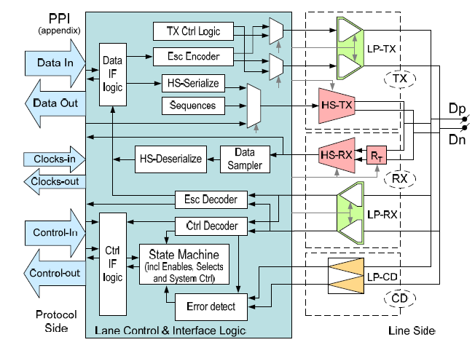
Universal Lane Module Architecture

Slide 10
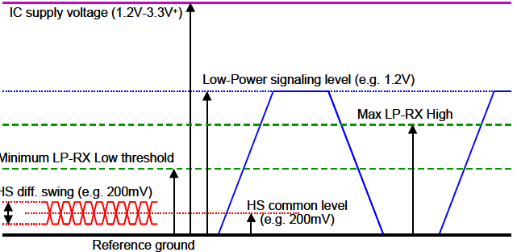
Lane States and Line Levels
  The two LP-TX’s drive the two Lines of a Lane independently and single-ended.
    Four possible Low-Power Lane states (LP-00, LP-01, LP-10, LP-11)
  A HS-TX drives the Lane differentially.
    Two possible High Speed Lane states (HS-0, HS-1)
  During HS transmission the LP Receivers observe LP-00 on the Lines
  Line Levels (typical)
    LP：0~1.2V
    HS：100~300mV (Swing：200mV)
  Lane States
    LP-00, LP-01, LP-10, LP-11
    HS-0, HS-1

Slide 11
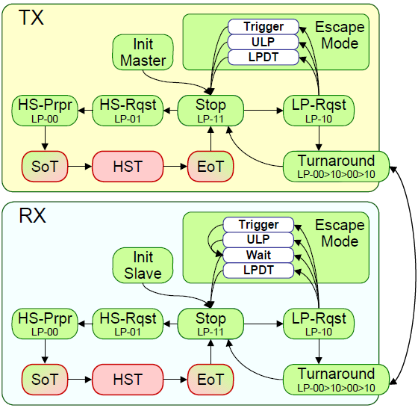
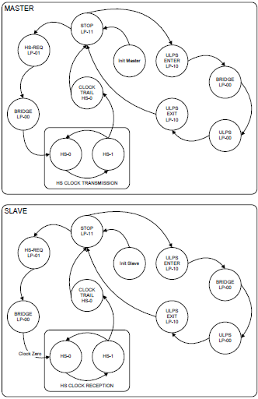
Operating Modes
  There are three operating modes in Data Lane
    Escape mode, High-Speed (Burst) mode and Control mode
  Possible events starting from the Stop State of control mode
    Escape mode request (LP-11→LP-10→LP-00→LP-01→LP-00)
    High-Speed mode request (LP-11→LP-01→LP-00)
    Turnaround request (LP-11→LP-10→LP-00→LP-10→LP-00)

Slide 12
Escape Mode
Escape mode is a special operation for Data Lanes using LP states.
  With this mode some additional functionality becomes available：LPDT, ULPS, Trigger
  A Data Lane shall enter Escape mode via LP-11→LP-10→LP-00→LP-01→LP-00
  Once Escape mode is entered, the transmitter shall send an 8-bit entry command to
  indicate the requested action.
  Escape mode uses Spaced-One-Hot Encoding.
  means each Mark State is interleaved with a Space State (LP-00).
  Send Mark-0/1 followed by a Space to transmit a ‘zero-bit’/ ‘one-bit’
  A Data Lane shall exit Escape mode via LP-10→LP-11
Ultra-Low Power State
  During this state, the Lines are in the Space state (LP-00)
  Exited by means of a Mark-1 state with a length TWAKEUP(1ms) followed by a Stop state.

Slide 13
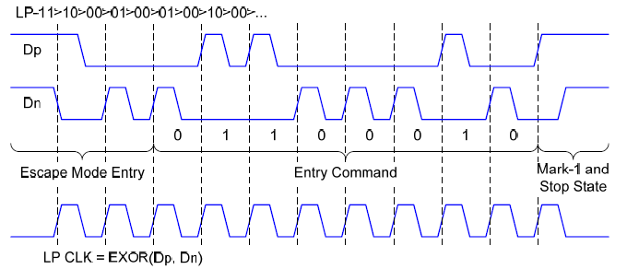
Escape Mode

Slide 14
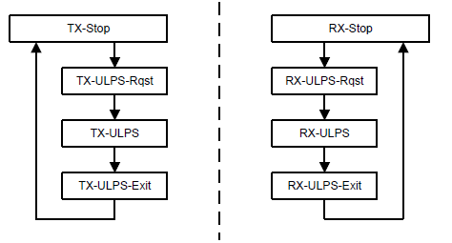
Clock Lane Ultra-Low Power State
A Clock Lane shall enter ULPS via
  LP-11→LP-10→LP-00
exited by means of a Mark-1 with a length TWAKEUP followed by a Stop State
  LP-10 → TWAKEUP →LP-11
  The minimum value of TWAKEUP is 1ms

Slide 15
High-Speed Data Transmission
The action of sending high-speed serial data is called HS transmission or burst.
 Start-of-Transmission
  LP-11→LP-01→LP-00→SoT(0001_1101)
  HS Data Transmission Burst
  All Lanes will start synchronously
  But may end at different times
  The clock Lane shall be in High-Speed mode, providing a DDR Clock to the Slave side
End-of-Transmission
  H Toggles differential state immediately after last payload data bit
 and keeps that state for a time THS-TRAIL

Slide 16
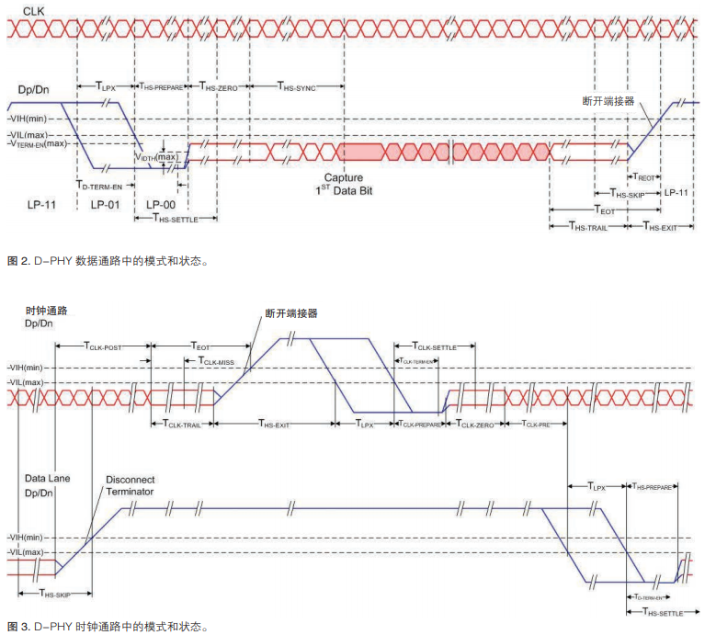
High-Speed Clock Transmission
Switching the Clock Lane between Clock Transmission and LP Mode
  A Clock Lane is a unidirectional Lane from Master to Slave
  In HS mode, the clock Lane provides a low-swing, differential DDR clock signal.
  the Clock Burst always starts and ends with an HS-0 state.
  the Clock Burst always contains an even number of transitions

Slide 17
Summary for D-PHY
Lane Module, Lane State and Line Levels
  Lane Module：LP-TX, LP-RX, HS-TX, HS-RX, LP-CD
  Lane States：LP-00, LP-01, LP-10, LP-11, HS-0, HS-1
  Line Levels (typical)：LP：0~1.2V, HS：100~300mV (Swing：200mV)
Operating Modes
  Escape Mode entry procedure ：LP-11→LP-10→LP-00→LP-01→LP-00→Entry Code → LPD (10MHz)
  Escape Mode exit procedure：LP-10→LP-11
  High Speed Mode entry procedure：LP-11→LP-01→LP-00→SoT(00011101) → HSD (80Mbps ~ 1Gbps)
  High Speed Mode exit procedure：EoT→LP-11
  Control Mode - BTA transmission procedure：LP-11→LP-10→LP-00→LP-10→LP-00
  Control Mode - BTA receive procedure：LP-00→LP-10→LP-11
System Power States
  Low-Power mode, High-Speed mode, Ultra-Low Power mode
Fault Detection
  Contention Detection (LP-CD), Watchdog Timer, Sequence Error Detection (Error Report)
Global Operation Timing Parameter
  Clock Lane Timing, Data Lane Timing
  Other Timing – Initialization, BTA, Wake-Up from ULPS
Electrical Characteristics
  HS-RX, LP-RX, LP-TX, LP-CD, Pin characteristic, Clock signal, Data-Clock timing
  DC and AC characteristic

Slide 18
Outline
DSI
  Introduction
  Lane Distributor/Merger Conceptual
  Packet Structure
  Data Transmission Way
  Processor-Sourced Packets
  Peripheral-Sourced Packets
  Reverse-Direction LP Transmission
  Video Mode
  Summary

Slide 19
Introduction for DSI
DSI is a Lane-scalable interface for increased performance.
  One Clock Lane / One to Four Data Lanes
DSI-compliant peripherals support either of two basic modes of operation
  Command Mode (Similar to MPU IF)
    Data Lane 0：bidirectional
      For returning data, ACK or error report to host
    Additional Data Lanes：unidirectional.
  Video Mode (Similar to RGB IF)
    Data Lane 0：bidirectional or unidirectional;
    Additional Data Lanes：unidirectional.
    Video data should only be transmitted using HS mode.
Transmission Mode
  High-Speed signaling mode
  Low-Power signaling mode
    Forward/Reverse direction LP transmissions shall use Data Lane 0 only
    For returning data, DSI-compliant systems shall only use Data Lane 0 in LP Mode
Packet Types
  Short Packet：4 bytes (fixed length)
  Long Packet：6~65541 bytes (variable length)

Slide 20
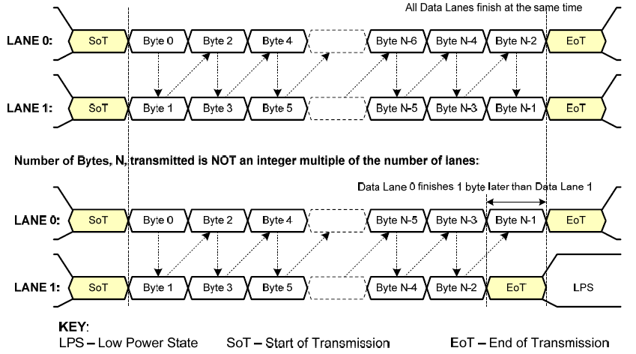
Two Data Lanes HS Transmission Example

Slide 21


Data Transmission Way
Separate Transmissions
Single Transmissions
KEY:
  LPS – Low Power State SP – Short Packet
  SoT – Start of Transmission LgP – Long Packet
  EoT – End of Transmission
Separate方式： 无论是short packet 或者 long packet传输，中间都会加上LPS.
Single 方式：在发完Short packet之后马上发送Long packet，不插入LPS.

Slide 22
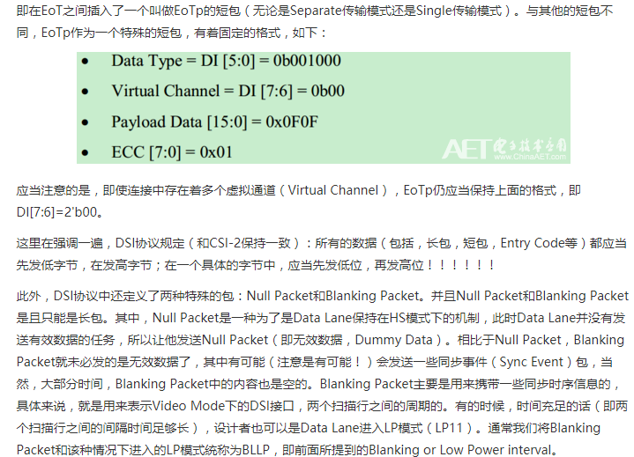

Slide 23
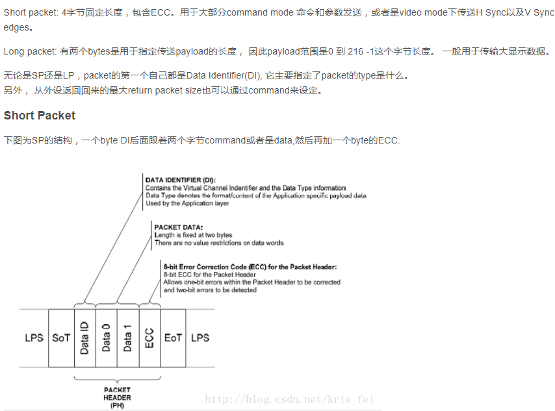
Short Packet Structure
Packet Header (4 bytes)
  Data Identifier (DI) * 1byte： Contains the Virtual Channel[7:6] and Data Type[5:0].
  Packet Data * 2byte：Length is fixed at two bytes
  Error Correction Code (ECC) * 1byte：allows single-bit errors to be corrected and 2-bit errors to be detected.
Packet Size
  Fixed length 4 bytes
The first byte of any packet is the DI (Data Identifier) byte.
  DI[7:6]：These two bits identify the data as directed to one of four virtual channels.
  DI[5:0]：These six bits specify the Data Type.

Slide 24
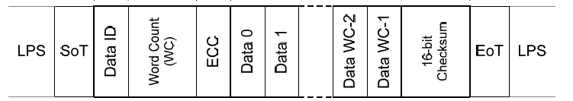
Long Packet Structure
Packet Header (4 bytes)
  Data Identifier (DI) * 1byte：Contains the Virtual Channel[7:6] and Data Type[5:0].
  Word Count (WC) * 2byte：defines the number of bytes in the Data Payload.
  Error Correction Code (ECC) * 1byte：allows single-bit errors to be corrected and 2-bit errors to be detected.
Data Payload (0~65535 bytes)
  Length = WC × bytes
Packet Footer (2 bytes)：Checksum
  If the payload has length 0, then the Checksum calculation results in FFFFh
  If the Checksum isn’t calculated, the Checksum value is 0000h
Packet Size
  4 + (0~65535) + 2 = 6 ~ 65541 bytes

Slide 25
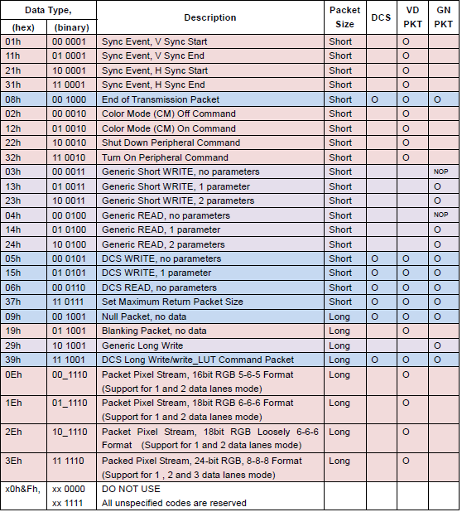
Data Types for Processor-sourced Packets

Slide 26
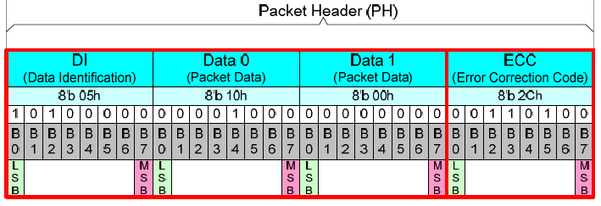
Error Correction Code
P7 = 0
P6 = 0
P5 = D10^D11^D12^D13^D14^D15^D16^D17^D18^D19^D21^D22^D23
P4 = D4^D5^D6^D7^D8^D9^D16^D17^D18^D19^D20^D22^D23
P3 = D1^D2^D3^D7^D8^D9^D13^D14^D15^D19^D20^D21^D23
P2 = D0^D2^D3^D5^D6^D9^D11^D12^D15^D18^D20^D21^D22
P1 = D0^D1^D3^D4^D6^D8^D10^D12^D14^D17^D20^D21^D22^D23
P0 = D0^D1^D2^D4^D5^D7^D10^D11^D13^D16^D20^D21^D22^D23

Slide 27
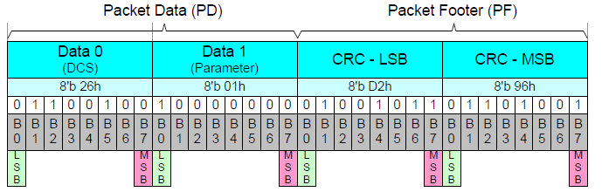
Checksum
unsigned char xx[] = {0x01,0x5a,0x5a,0x03,0x08,0x2A, 0x00,0x01
,0x00,0xF8,0x00,0xF6,0x57,0x00,0X00,0xE5};
typedef unsigned short U16;
typedef unsigned char U8;
U16 CRC_test;
U16 crc16_update(U16 crc, U8 a);
int main()
{
U16 crc,i;
crc = 0xFFFF;
for (i=0; i<1; i++) crc = crc16_update(crc, xx[i]);
CRC_test = crc;
}
U16 crc16_update(U16 crc, U8 a)
{
int i;
crc ^=a;
for (i = 0; i < 8; ++i)
{
if (crc & 1) crc = (crc >> 1) ^ 0x8408;
else crc = (crc >> 1);
}
return crc;
}

Slide 28
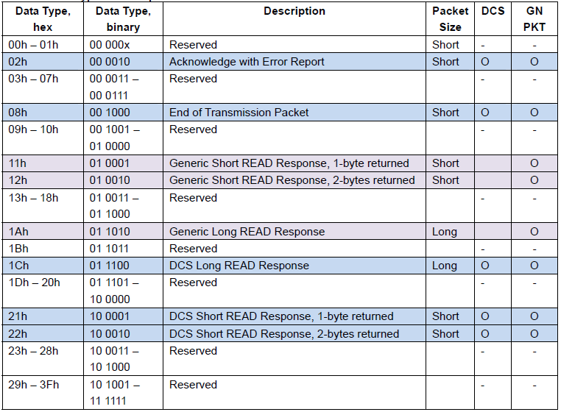
Peripheral-to-Processor LP Transmissions
Detailed format description
  Packet structure for peripheral-to-processor transactions is the same as for
  the processor-to-peripheral direction
For a single-byte read response, valid data shall be returned in the first byte The second byte shall be sent as 00h
If the peripheral does not support Checksum it shall return 0000h

Slide 29
Peripheral-to-Processor LP Transmissions
Peripheral-to-processor transactions are of four basic types
  Tearing Effect (TE)：trigger message (BAh)
  Acknowledge：trigger message (84h)
  Acknowledge and Error Report：short packet (Data Type is 02h)
  Response to Read Request：short packet or long packet
    Generic Read Response、DCS Read Response（1byte, 2byte, multi byte）
Feature
  BTA shall take place after every peripheral-to-processor transaction
  Multi-Lane systems shall use Lane 0 for all peripheral-to-processor transmissions
  Reverse-direction signaling shall only use LP mode of transmission

Slide 30
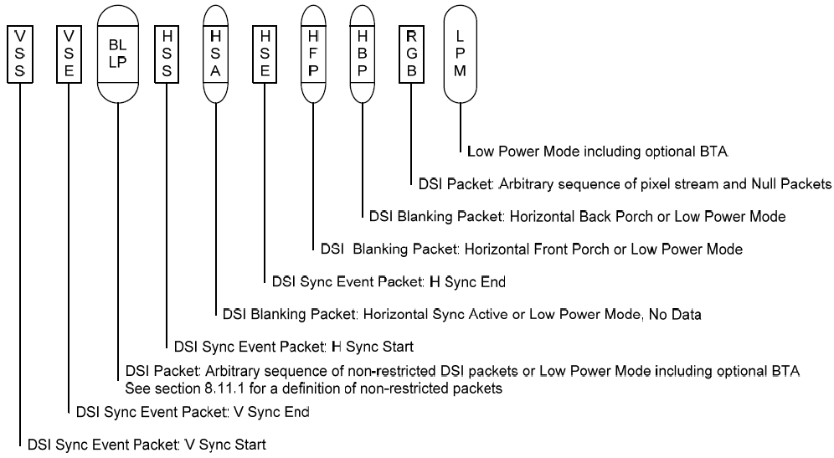
Video Mode
DSI supports three formats for Video Mode data transmission
  Non-Burst Mode with Sync Pulses
  Non-Burst Mode with Sync Events
  Burst Mode

Slide 31
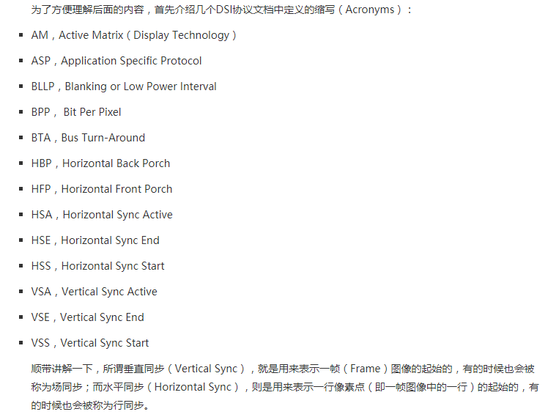

Slide 32
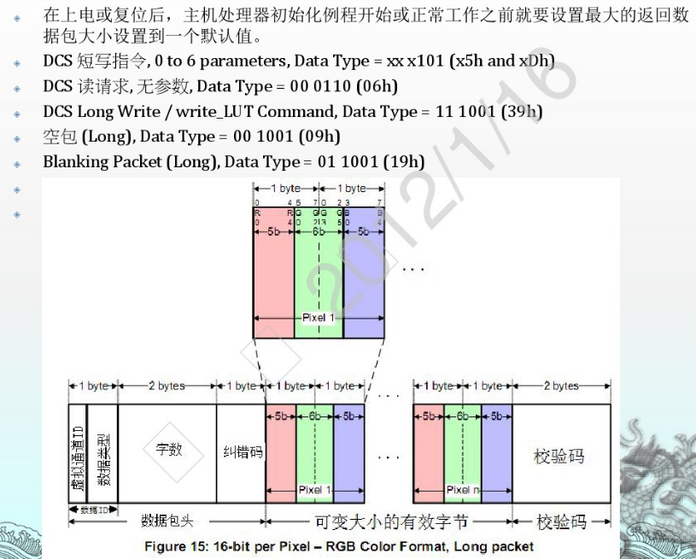

Slide 33
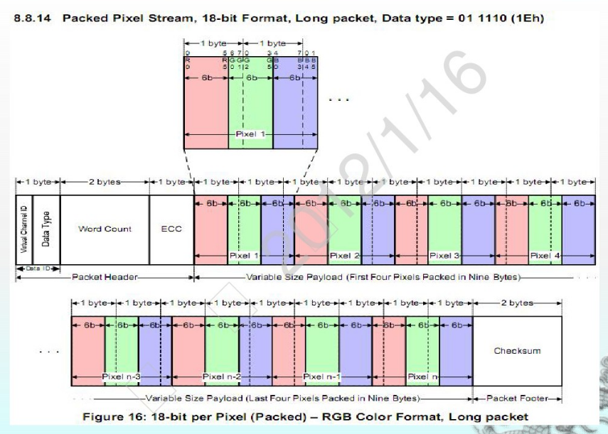

Slide 34
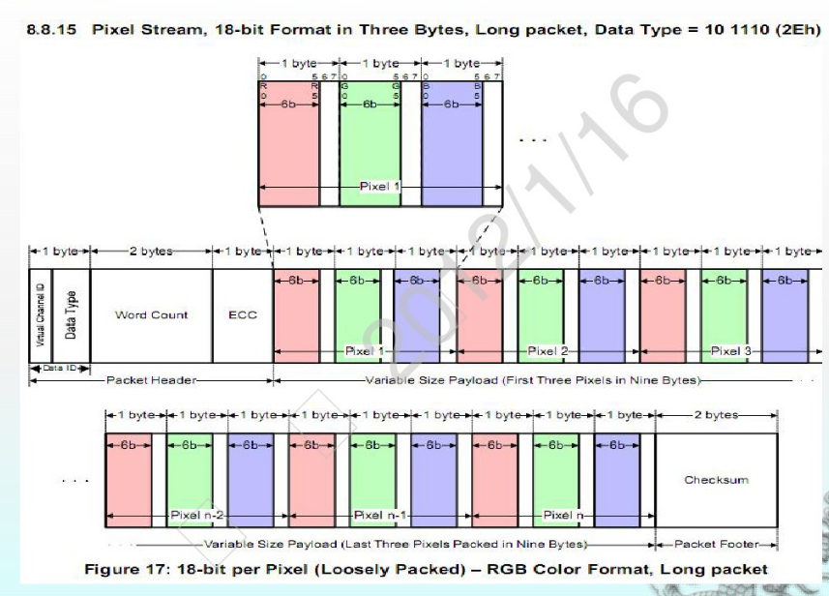

Slide 35
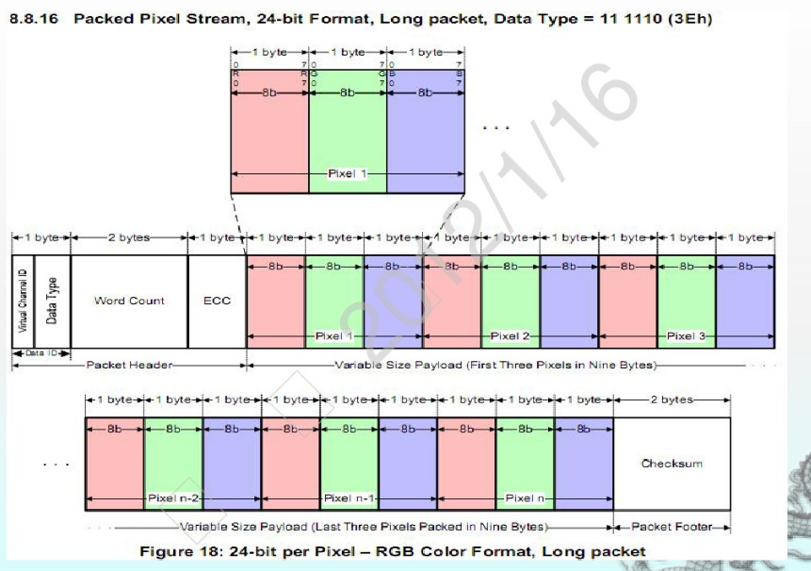

Slide 36
Summary for DSI
DSI is a Lane-scalable interface.
  One Clock Lane
  One to Four Data Lanes
Transmission Mode
  High-Speed signaling mode (differential signal) (100mV~300mV)
  Low-Power signaling mode (single-ended signal) (0V~1.2V)
    For returning data, only use Data Lane 0 in LP Mode
Packet Types
  Short Packet：4 bytes (fixed length)
    Data ID (1byte) + Data0 (1byte) + Data1 (1byte) + ECC (1byte)
  Long Packet：6~65541 bytes (variable length)
    Packet Header (4 bytes) + Data Payload (0~65535 bytes) + Packet Footer (2 bytes)
Operation Mode
  Command Mode (Similar to MPU IF)
  Video Mode (Similar to RGB IF)
    Non-Burst Mode with Sync Pulses
    Non-Burst Mode with Sync Events
    Burst Mode

Slide 37
Thank you!

